Slide 1
SLEEP_HEALTH_LIFECYCLE
Real world Power BI Project
By Aishwarya kadam

Slide 2
Steps:
Data Importing
Data Cleaning
Data Processing
Dashboard creation with the help of PowerBI

Slide 3
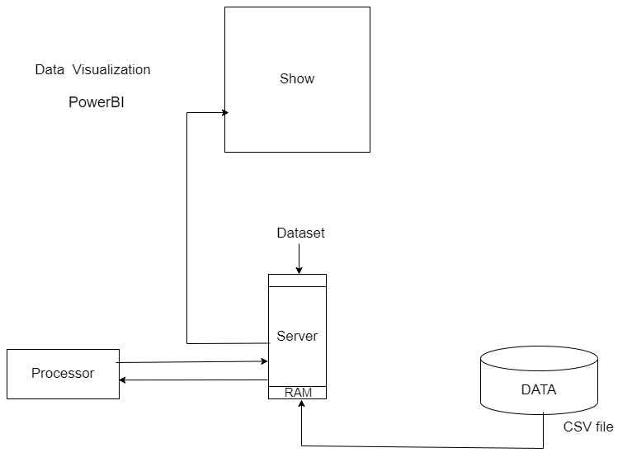

Slide 4
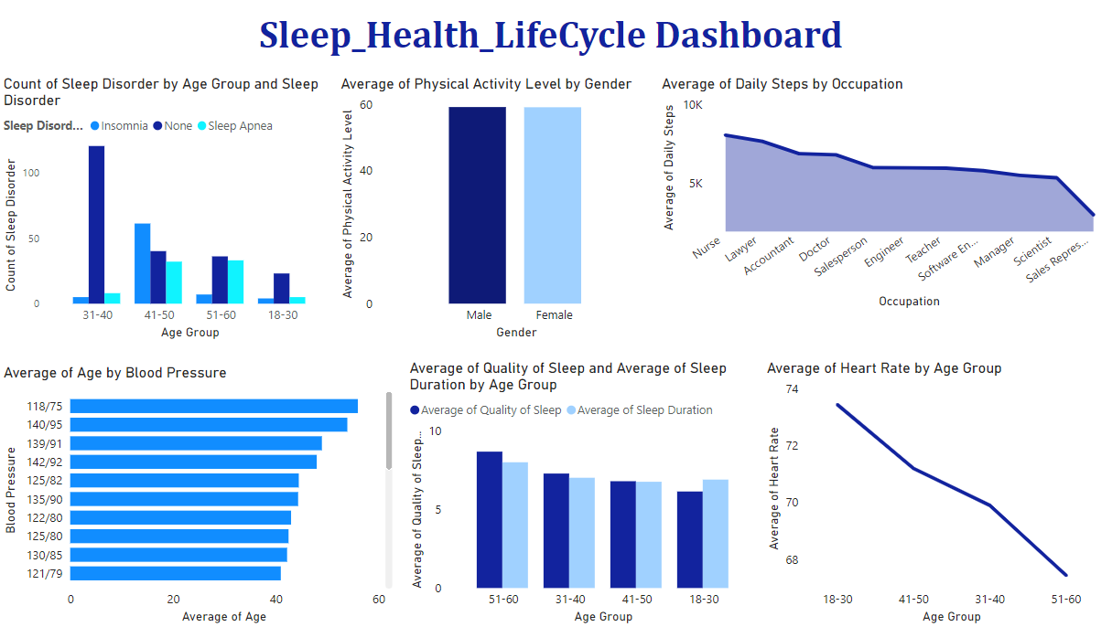

Slide 5
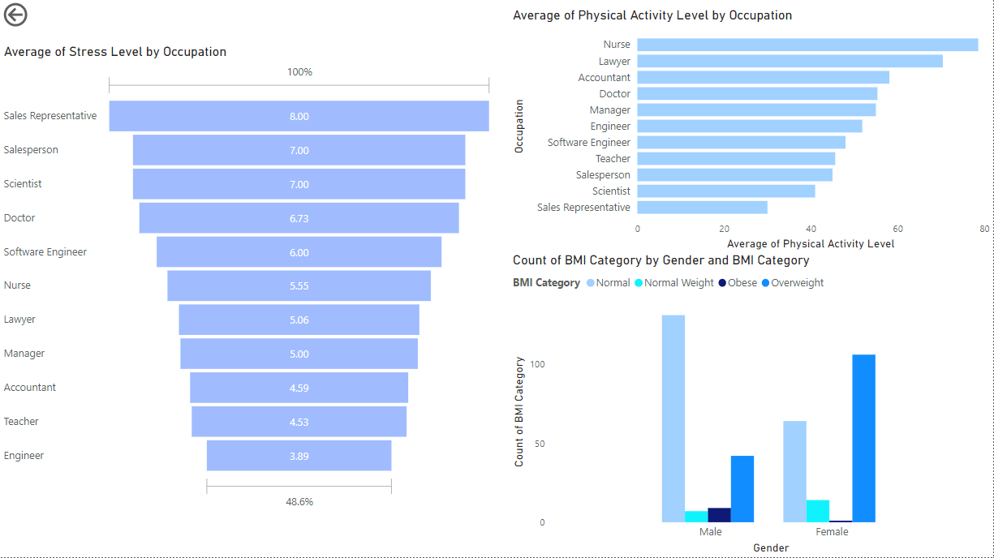

Slide 6
Conclusion:
From the given information we have concluded that sales representatives, salespersons, scientists, doctors are more stressed than other professions so we can conduct some seminars / Meetings for them regarding , how to reduce stress & how to handle the situations without getting stressed .

